Slide 1

Diabetic Retinopathy Detection
Capstone Project
Team no 5
SL.no | Student Name | USN | Roll no | Division
1 | Sandeep Kulkarni | 01fe21bcs105 | 114 | A
2 | P Sai Sudheer | 01fe21bcs096 | 417 | D
3 | Praneet Mane | 01fe21bcs104 | 418 | D
4 | Varun M K | 01fe21bcs110 | 367 | C
5 | Srivathsa Acharya | 01fe21bcs083 | 414 | D
Guide: Gururaj Hanchinamani

Slide 2

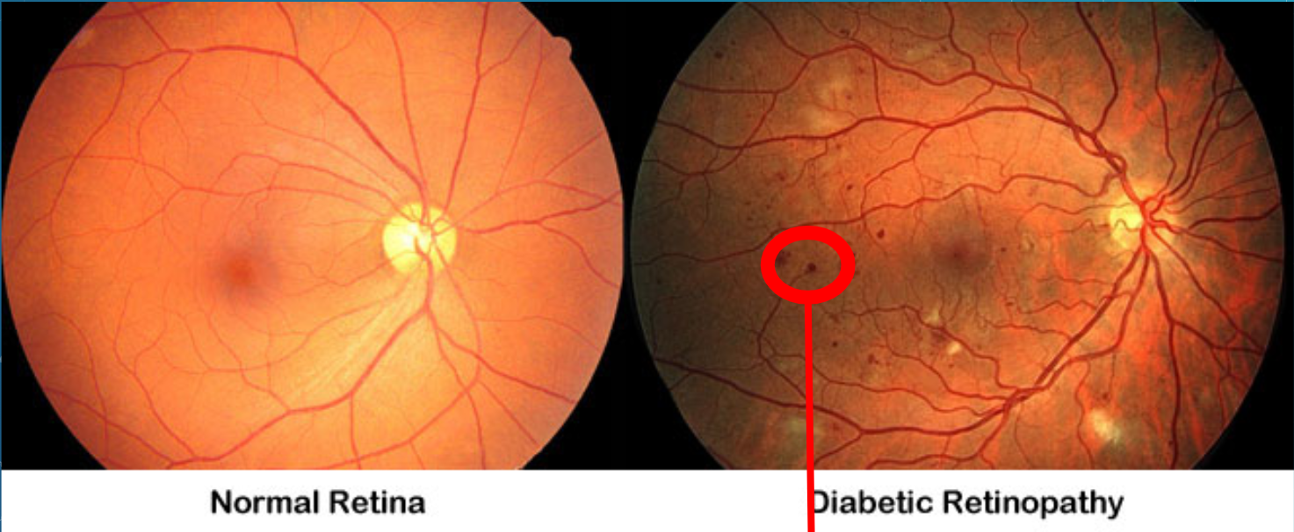
Introduction
DR is caused by prolonged high blood sugar levels in diabetic patients, leading to retinal blood vessel damage and potential blindness.
Regular eye screening and early diagnosis can prevent vision loss, as DR may not show symptoms in the early stages.
AI-based automated detection systems are improving early diagnosis by analyzing retinal images, making DR detection faster and more accessible

Slide 3
Motivation
Preventing Vision Loss: Diabetic Retinopathy is a leading cause of blindness, and early detection can significantly reduce the risk of severe vision impairment.
Growing Diabetic Population: With the increasing number of diabetes cases worldwide, there is a rising need for efficient and scalable DR screening methods.
Need for Automated Diagnosis: Traditional DR diagnosis is time-consuming and requires expert ophthalmologists, while AI-driven solutions can provide faster and more accurate results.

Slide 4

Literature Survey:
Authors | Title | Methodology | Dataset | Result | Gap
Shwetha G.K., Udaya Kumar Reddy K R, Jayantkumar Rathod, Sathyaprakash B.P, Lolakshi P K | Diabetic Retinopathy Prediction using Modified Inception V3 Model Structure | Used Modified Inception V3 model for DR detection. Applied pre-processing techniques such as green channel separation, histogram equalization, contrast enhancement, and scaling. - Extracted 14 statistical attributes from processed images. - Proposed a novel approach for optic disc detection using significant blood vessel intersections. | Retinal fundus images from a publicly available dataset. Additional images processed using morphological techniques. | Achieved an accuracy of 91.3%. Specificity: 89.5% Improved detection of microaneurysms and hemorrhages. | Difficulty in handling unprocessed retinal fundus images. Need for further improvements in early-stage DR detection. Requirement for enhanced generalization across diverse patient populations.

Slide 5
Literature Survey:
Authors | Title | Methodology | Dataset | Result | Gap
Revathy R , Nithya B S, Reshma J J, Ragendhu S S, Sumithra M D (IJERT-June 2020) Sumithra M D Sumithra M D M D | Diabetic Retinopathy Detection using Machine Learning | RGB to HSV conversion, edge zero padding, median filtering, and adaptive histogram equalization. Segment exudates (smoothing, masking, bitwise AND) and hemorrhages/microaneurysms (blurring, thresholding, erosion, dilation). Hybrid model: SVM, KNN, Random Forest with voting mechanism for final prediction. | Publicly available Kaggle Dataset with 1000 images with DR, 1000 without DR, and 122 with DR + 122 normal images. | Performance Metrics: Accuracy: SVM: 68% KNN: 76% Random Forest: 90% Hybrid Model (Voting): 82% Precision: 0.8619 Recall: 0.8116 F-measure: 0.8028. | struggles to distinguish mild vs severe DR, performance drops with large exudates, and limited dataset (244 images) lacking detection of cotton wool spots or neovascularization.

Slide 6
Literature Survey:
Authors | Title | Methodology | Dataset | Result | Gap
Sükran Yaman Atcı, Ali Güne¸s, Metin Zontul, and Zafer Arslan (Tomography - Feb 5, 2024) | Identifying Diabetic Retinopathy in the Human Eye: A Hybrid Approach Based on a Computer-Aided Diagnosis System Combined with Deep Learning | Used a hybrid deep learning approach combining multiple models like EfficientNet-B3/B7, weight fusion, and a custom classifier to detect DR. SHAP explains prediction & cyclical LR improves training. | Kaggle dataset (5590 retinal images with 5 DR gradations). | The study achieved precision scores of 93%, 89%, 81%, 76%, and 96% for normal, mild, moderate, severe, and DR phases, respectively | Improper performance evaluation measures. Limitations of current CADs in detecting subtle/early-stage DR. Need for better adaptability across different populations.

Slide 7
Literature Survey:
Authors | Title | Methodology | Dataset | Result | Gap
Abdul Rahaman, Wahab Sait (MDPI-October 3, 2023) | A Lightweight Diabetic Retinopathy Detection Model Using a Deep-Learning Technique. | Used You Only Look Once (Yolo) V7 for feature extraction. Used a hyperparameter-optimized MobileNet V3 model for classification. Implemented image pre-processing techniques such as CLAHE and Wiener filtering to enhance image quality. | APTOS dataset: 5,590 fundus images. | Achieved 89.0% accuracy and an F1-score of 93.7% on the APTOS dataset. | The model requires further improvements to detect DR from low-quality fundus images. Limited by the small dimension of DR severity indicators in fundus images, affecting prediction accuracy.

Slide 8
Problem Statement
Develop an automated deep learning model using Convnext_tiny architecture for early Diabetic Retinography detection.

Slide 9
Objectives
1. To develop an automated system for accurate DR detection.
2.To improve detection at early stages to prevent vision loss.
3. To optimize performance for consistent and accurate results.
4. To use techniques to reduce computational costs and improve processing speed.

Slide 10
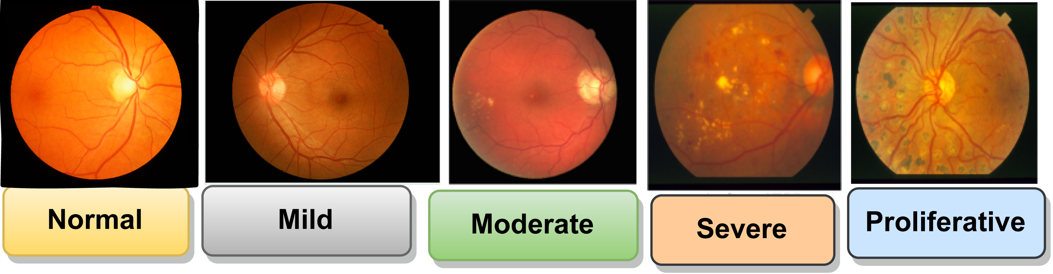
Dataset Description
The dataset comprises a total of 6148 medical X-ray images categorized based on severity levels: Mild, Moderate,No-DR,Proliferative, and Severe.
Train set: 7094 images
Validation set: 2234 images
Test set: 920 images
Labels are provided in .csv format and images are stored in corresponding directories.
Preprocessing includes resizing, normalization, and data augmentation using FastAI.

Slide 11
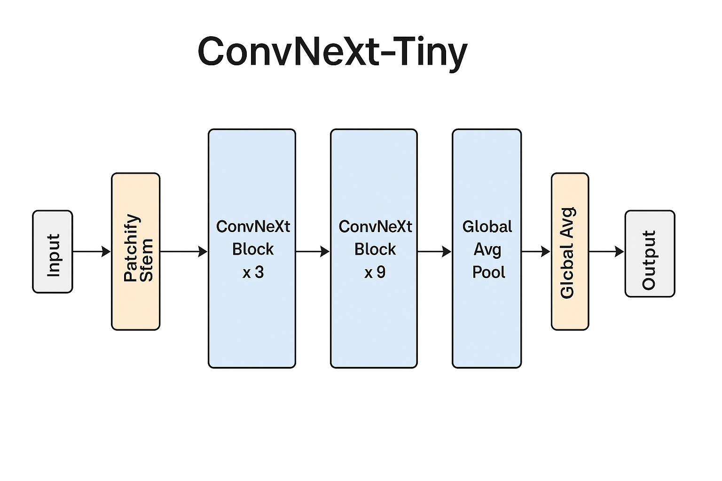
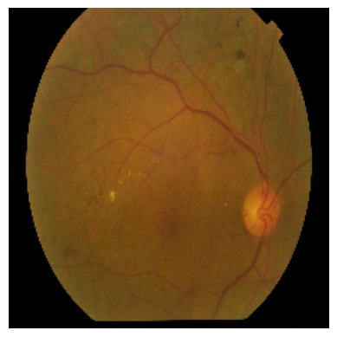
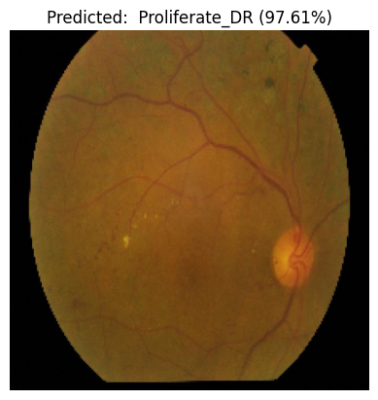
System architecture
ConvNeXt-Tiny is the best (in its class) because it gives you Transformer-like accuracy in a simple, compact, and efficient CNN form—ideal for real-world deployment without the Transformer overhead.
Key Idea: Keep the convolutional backbone, but tweak it with smarter architecture choices—so it performs like a Transformer without needing attention mechanisms.

Slide 12
Algorithm
Input image
Apply 1×1 Conv layer → BatchNorm → ReLU
Repeat 16 times:
For each Bottleneck Block:
1×1 Conv → BatchNorm → ReLU
3×3 Conv → BatchNorm → ReLU
1×1 Conv → BatchNorm
Add input (residual connection)
Apply ReLU
Apply Fully Connected layer
Apply Softmax for class prediction

Slide 13
Workflow
Dataset Collection
Model Architecture Selection
Model Training
Inference and Prediction

Slide 14
Methodology
1. Dataset Collection
Collected 5094 training, 734 validation, and 320 testing retinal fundus images.
Labels include: No-DR, Proliferative DR, Severe DR, etc.
2. Model Architecture Selection
Chose ConvNeXt-Tiny for its modernized CNN design with Transformer-level accuracy and lightweight efficiency
Utilized a pretrained model on ImageNet and fine-tuned it on our custom dataset for improved performance
3. Model Training
Utilized FastAI’s vision_learner for seamless model setup.
Trained the model using .fine_tune(15), optimizing over 15 epochs.
Applied data augmentation and resizing to improve generalization.
4. Inference & Prediction
Evaluated model on the test set to compute accuracy and loss.
Performed single image predictions with the Output of predicted class and confidence score.

Slide 15
Results
Achieved 85% validation accuracy using Convnext_tiny after fine-tuning on the DR dataset.
Visual predictions show high confidence, with most misclassifications between similar DR stages.

Slide 16
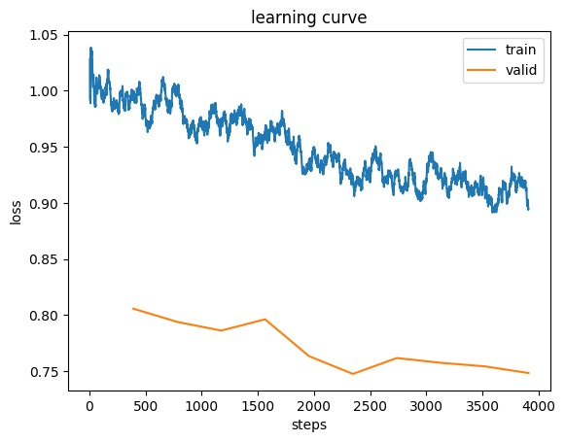
Results
The learning curve shows that both training and validation losses are gradually decreasing, indicating that the model is learning and improving its performance over time without overfitting.

Slide 17
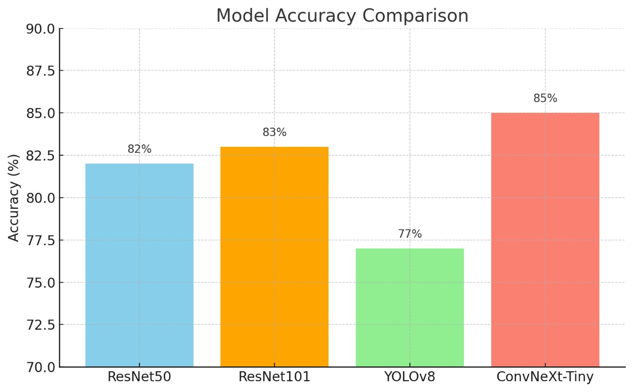
Results
The bar chart shows that ConvNeXt-Tiny achieved the highest accuracy (85%), outperforming ResNet50, ResNet101, and YOLOv8 models on DR detection.

Slide 18
References
[1] Wahab Sait, Abdul Rahaman. 2023. "A Lightweight Diabetic Retinopathy Detection Model Using a Deep-Learning Technique" Diagnostics 13, no. 19: 3120. https://doi.org/10.3390/diagnostics13193120
[2] Sükran Yaman Atcı, Ali Güne¸s, Metin Zontul, and Zafer Arslan. 2024. "Identifying Diabetic Retinopathy in the Human Eye: A Hybrid Approach Based on a Computer-Aided Diagnosis System Combined with Deep Learning" Tomography 10, no. 2: 215–230. https://doi.org/10.3390/tomography10020017
[3] Revathy R,Nithya B S,Reshma J J,Ragendhu S S,Sumithra M D.2020 . "Diabetic Retinopathy Detection Using Machine Learning " TY - JOUR AU - R, Revathy PY - 2020/06/10 SP - T1 - Diabetic Retinopathy Detection using Machine Learning VL - V9 DO - 10.17577/IJERTV9IS060170 JO - International Journal of Engineering Research and ER.
[4] Shwetha G.K., Udaya Kumar Reddy K R, Jayantkumar Rathod, Sathyaprakash B.P, Lolakshi P K .2023 "Diabetic Retinopathy Prediction using Modified Inception V3 Model Structure " G. K., S. ., Reddy K. R., U. K. ., A. Rathod, J. ., B. P., S. ., & P. K., L. . (2023). Diabetic Retinopathy Prediction using Modified Inception V3 Model Structure. International Journal of Intelligent Systems and Applications in Engineering, 11(1), 261–268. Retrieved from https://ijisae.org/index.php/IJISAE/article/view/2466.

Slide 19
THANK YOU

